Slide 1
HEALTH INSURANCE LEAD PREDICTION
AKARSH PV

Slide 2
PROBLEM statement
A Financial Company is looking to leverage their client base by cross selling insurance products to existing customers. Insurance policies are offered to existing clients based on website landing and consumer election to fill out additional information forms. The company would like to leverage their acquired information to classify positive leads for outreach programs using machine learning classifiers.

Slide 3
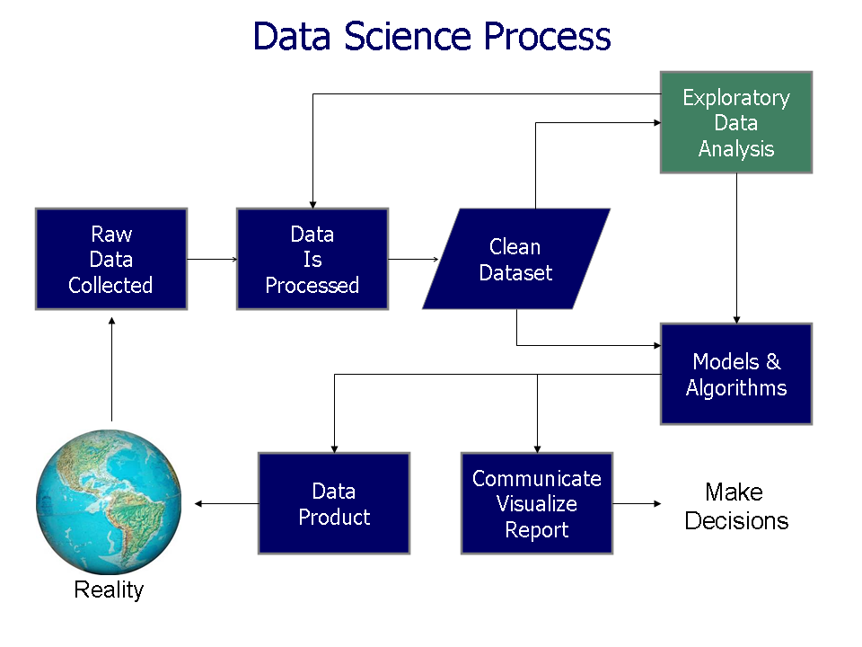

Slide 4
MODEL SELECTION
MODEL | ACCURACY | PRECISION | RECALL | F1-SCORE
Logistic Regression | 75.71 | 1.00 0.00 | 0.76 0.00 | 0.86 0.00
Decision Tree | 66.85 | 0.77 0.34 | 0.78 0.32 | 0.78 0.33
Ada Boost | 66.64 | 0.77 0.34 | 0.78 0.32 | 0.78 0.33
XG Boost | 75.65 | 0.98 0.07 | 0.77 0.49 | 0.86 0.12
Random Forest | 75.40 | 0.99 0.03 | 0.76 0.41 | 0.86 0.06
KNN | 75.70 | 1.00 0.00 | 0.76 0.00 | 0.86 0.00
Naïve Bayes | 49.13 | 0.48 0.53 | 0.76 0.24 | 0.59 0.33
SVM | 75.71 | 1.00 0.00 | 0.76 0.00 | 0.86 0.00

Slide 5
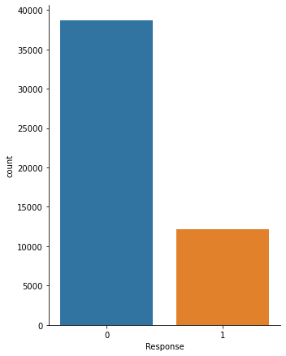
Target column

Slide 6
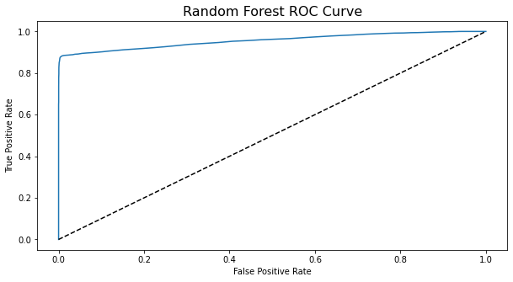
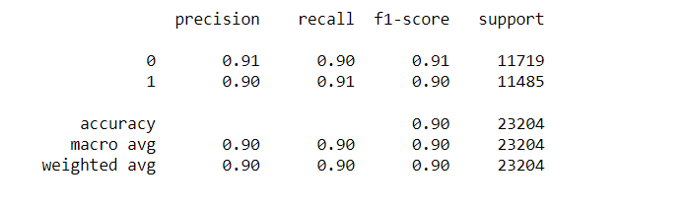
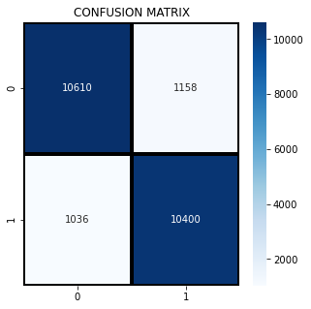
evaluation
Random Forest Model Scored:

Slide 7
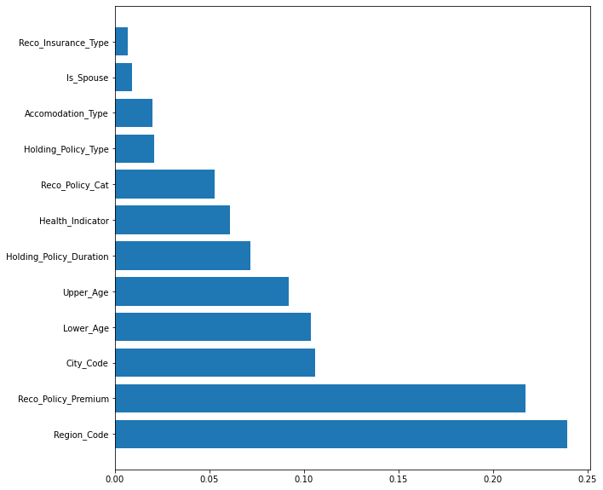
Feature engineering
TOP FEATURES
Recommended Policy Premium
Region Code
City Code
Age
Region Code consists of far too many categorical values. So the feature is not using as the data still retains the 'City Code' feature to capture some level of geographical distinction.

Slide 8
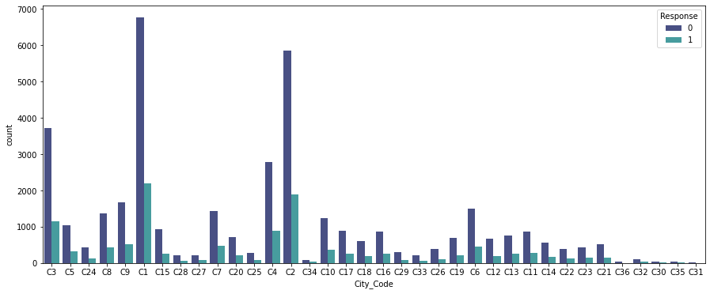
City code
City Codes C1,C2 and C3 have better positive responses.
So target clients living in these areas.

Slide 9
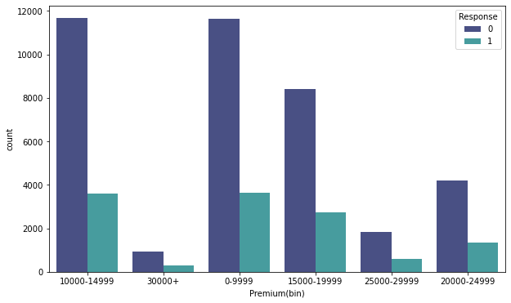
Recommended Policy premium
Try to sell the premiums less than 19,999.

Slide 10
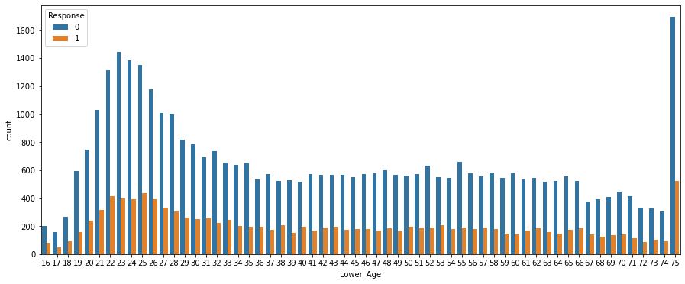
Age
Target the clients with age group of 21-27 and 75.

Slide 11
recommendations
The model's top features were: Age, Reco Policy Premium and City Code.
It is recommended to focus on clients in/with :
• City Code: C1, C2, C3
• Reco Policy Premiums: Less than 19,999.
• Age Groups: 21-27 and 75

Slide 12
Thank you

